Slide 1

Coimbatore Institute of Technology
Department of Computer Science and Engineering
1905018 | Harshitha B.
1905022 | K.Shiva Baba
1905023 | Kavinraja.R
1905036 | Pranav Devi R.
1905056 | Vaibav Bajra S.
Guided by
Dr. A.Priyadharshini

Slide 2

Preliminary Self-diagnosis and Recommender System (PreSARS)

Slide 3
Overview
Problem Statement
Impact
Objective
Proposal
Workflow
Notes:
overview

Slide 4
The Problem
People encounter health complications and do not know how to react. So they ask google.
Ignoring a severe issue leads to fatality.
To pay regard more than necessary causes stress.
Misled diagnosis and self medication is dangerous.

Slide 5
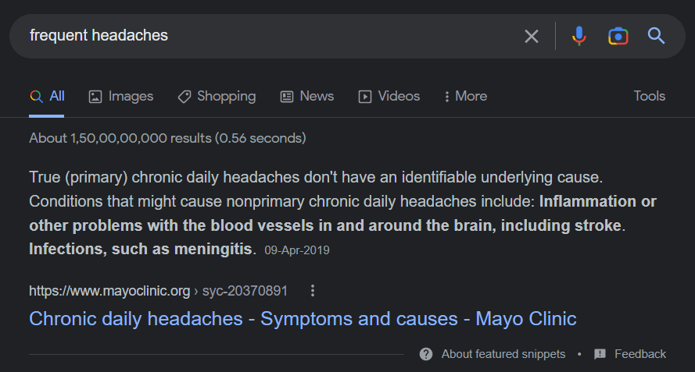

Slide 6
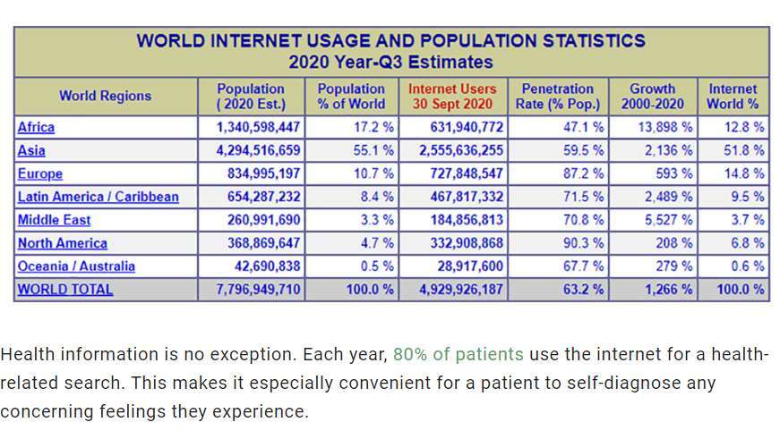
Statistics
Notes:
80% use internet to self diagnose. 4 in 5 people do this. Hence this is serious.

Slide 7
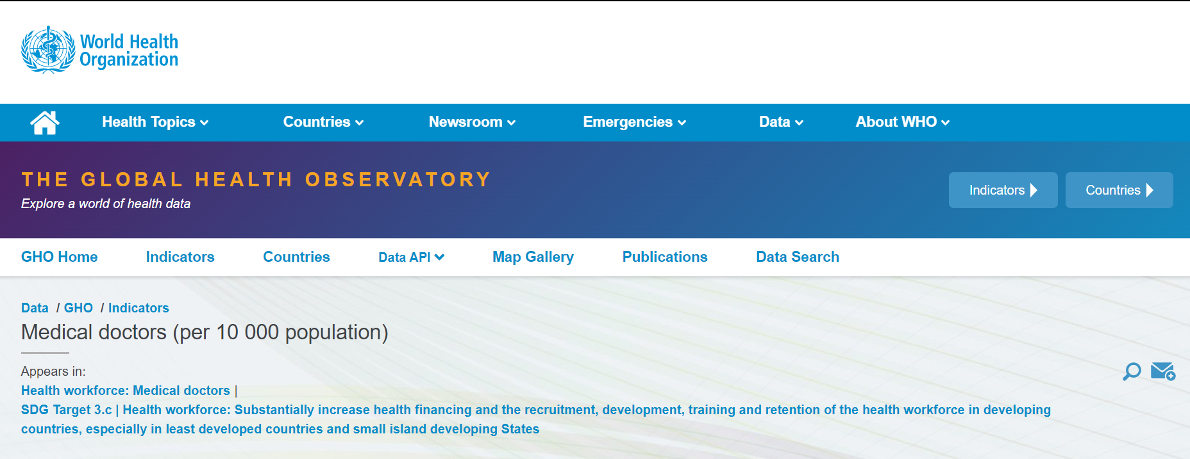
STATS

Slide 8
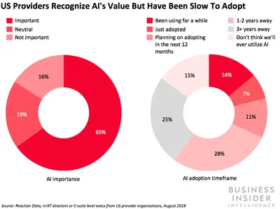
The use of AI in diagnostic imaging, clinical decision support, and precision medicine offers the greatest cost savings and efficiency opportunities across hospitals. (2019)
Notes:
Harshitha

Slide 9
Here are some of the Indian AI healthcare firms that are revolutionizing the sector:
DocTalk: It is a smartphone application based in Mumbai that allows patients to save their medical papers and history on the cloud. Users can also communicate with their doctors and obtain medications while on the go by using the app. The plan is to develop AI-powered, on-demand virtual assistant software to help simplify the Indian healthcare environment.
Dozee: It is a Bengaluru-based AI healthcare firm. Dozee produces contactless health monitors that silently detect heart, respiration, sleep patterns, stress levels, cardiac contractions, apnea, and other vital signs while sleeping. In addition, its artificial intelligence systems detect any health worsening early.
Niramai: It offers Thermalytix, a device that employs an AI-based high-resolution thermal sensor for the early detection of breast cancer. Cancer screening is now possible in clinics across India because of the automated, low-cost, and portable software-based medical gadgets.
Notes:
Harshitha

Slide 10
Impact
Improper self-diagnosis
Incorrect self-medication
Fatal results by overlooking symptoms
Stress from misinterpretation, and Hopelessness
Generalized solution for a personal problem
Notes:
Harshitha

Slide 11
Objective
To identify an underlying medical condition using Artificial Intelligence and help people with adequate measures to overcome the problem.
Notes:
Harshitha

Slide 12
Proposal
An Artificial Intelligence based system that identifies health conditions using different models and aid patients in performing appropriate actions.
Notes:
P

Slide 13
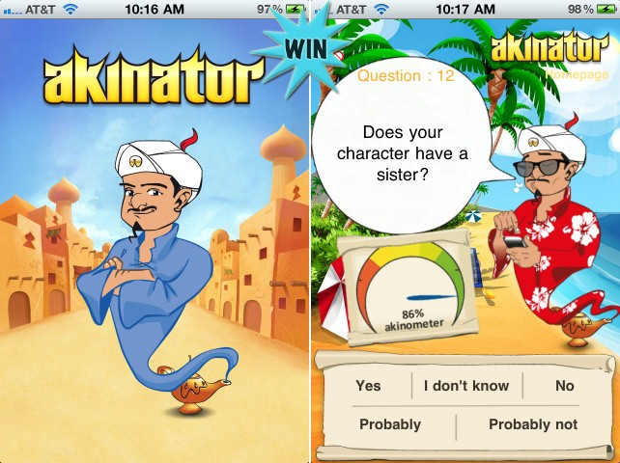
The Akinator.
https://en.akinator.com/
Notes:
P

Slide 14
The Akinator
A database made up of about 100000 characters with different fields describing them.
This is the initial set of solutions that is reduced every time you answer one of the questions, until only one remains.
If the algorithm doesn't find a solution after asking 20 questions, you can add your own character to the list.
Notes:
Decision tree kinda algorithm
Fuzzy logic
P

Slide 15
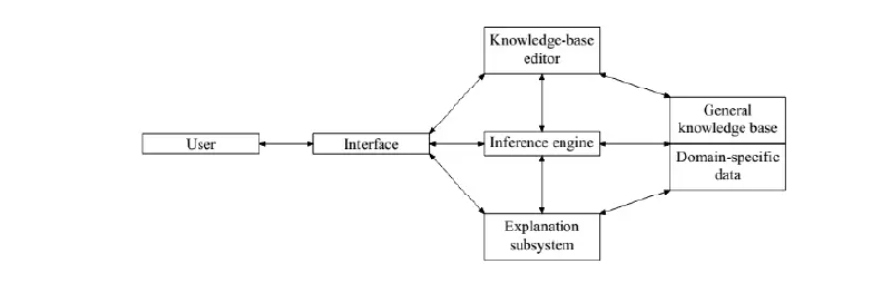
Architecture
Notes:
P

Slide 16
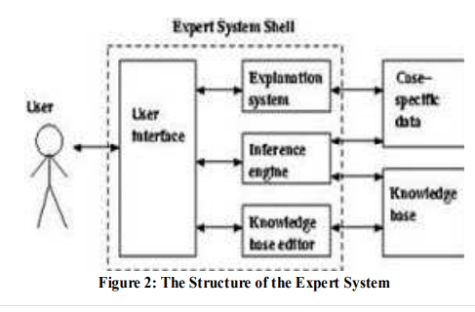
Base paper
-Expert Systems in Medical Diagnosis
-Nkuma-Udah, Kenneth & Onwodi, Gregory & Njoku, D. & Ndubuka, Gideon. (2013). Expert Systems in Medical Diagnosis. 10.13140/RG.2.2.21545.95843.

Slide 17
Abstract
To reduce the harm caused by improper self diagnosis and medication, an Artificial Intelligence system using different models is used. Comparing multiple methods help in improving the accuracy of the entire system by combining insights from various models. In addition to that, the user is directed to the right doctor to make diagnosis and recuperation, quicker and effective. The platform is aimed at being interactive and gamified to provide seamless experience to the user.
Notes:
Abstract carries issue, design, research, findings and conclusions
P

Slide 18
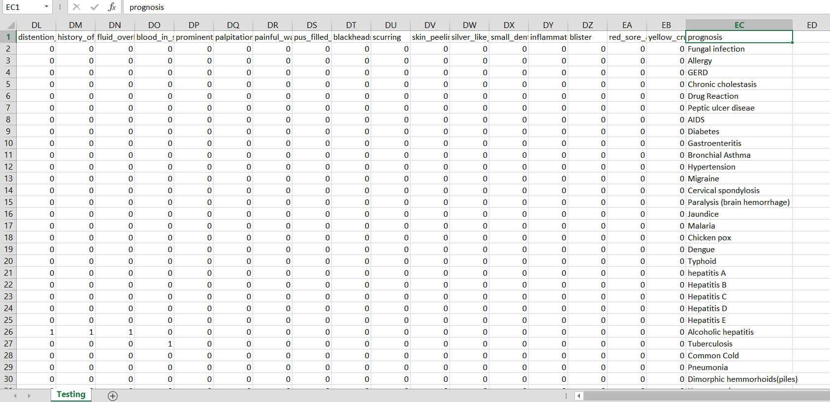
Dataset
132 symptoms taken as input
42 different types of diseases
Notes:
P

Slide 19
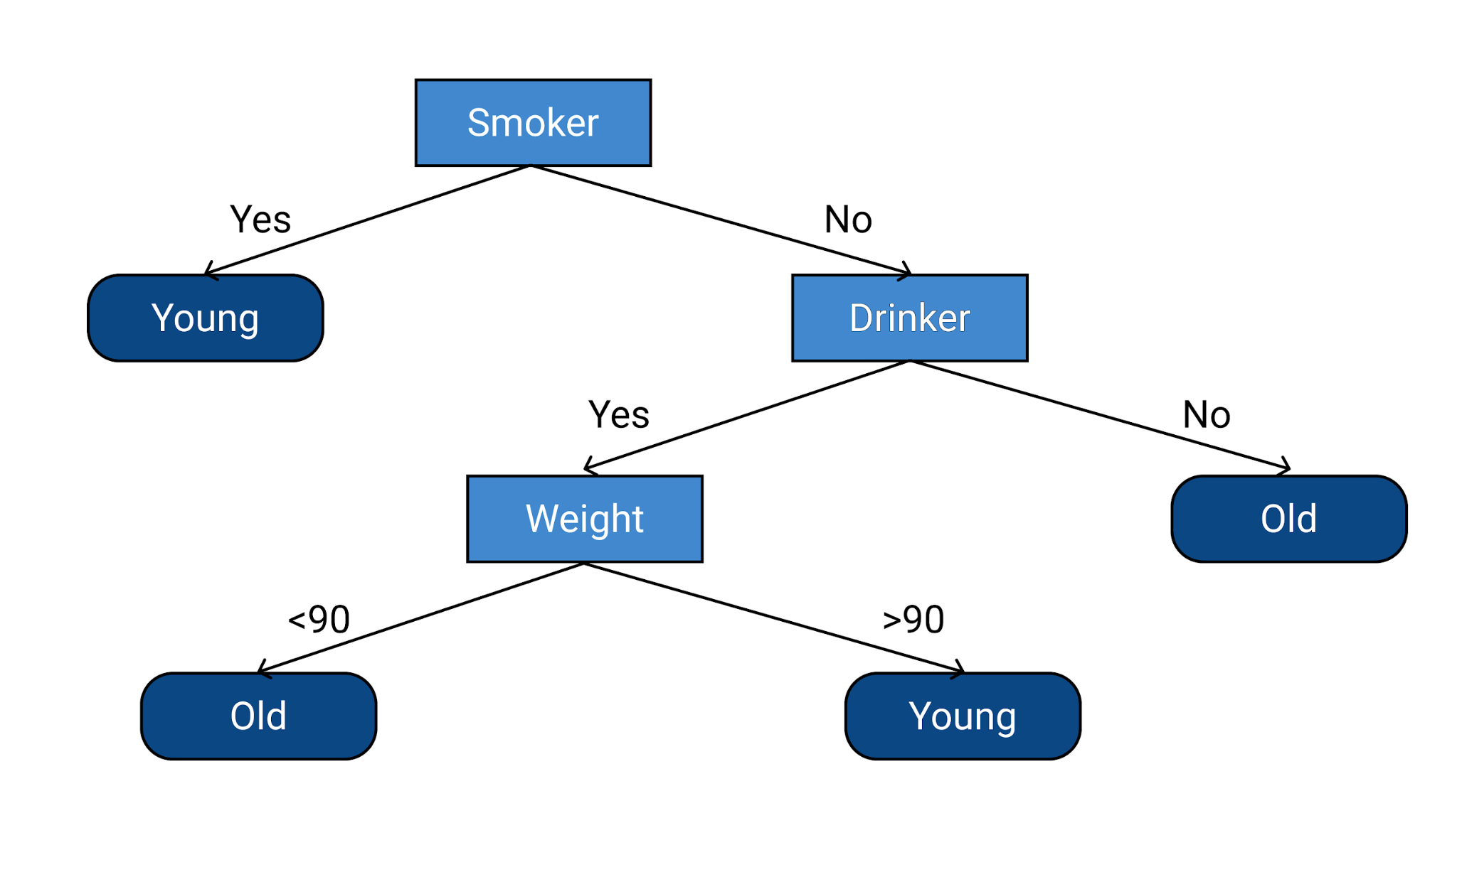
Decision Trees
Decision tree is a flowchart-like tree structure
Each internal node denotes a test on an attribute
Each branch represents an outcome of the test
Each leaf node (terminal node) holds a class label.

Slide 20
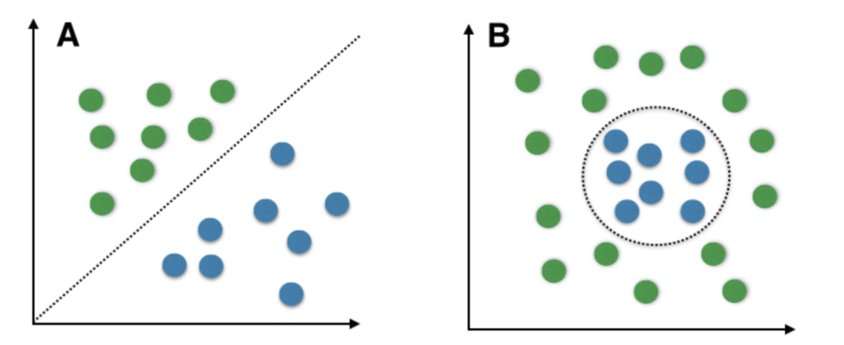
SVM Classifier
Type of supervised learning algorithm
Used for classification and regression tasks.
Find a hyperplane that maximally separates the different classes in the training data.
Hyperplane that has the largest margin is identified
Defined as the distance between the hyperplane and the closest data points from each class.
New data classified by determining on which side of the hyperplane it falls.
Used as a clear margin of separation is found in the data.

Slide 21
Bayesian
Bayes’ Theorem finds the probability of an event occurring given the probability of another event that has already occurred
Basically, we are trying to find probability of event A, given the event B is true. Event B is also termed as evidence.
P(A) is the priori of A (the prior probability, i.e. Probability of event before evidence is seen). The evidence is an attribute value of an unknown instance(here, it is event B).
P(A|B) is a posteriori probability of B, i.e. probability of event after evidence is seen.

Slide 22
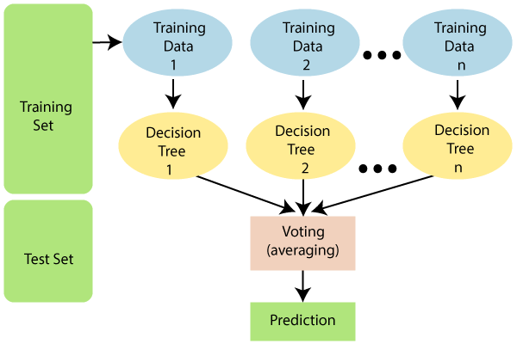
Random Forest
Contains a number of decision trees on various subsets of the given dataset
Takes the average to improve the predictive accuracy of that dataset.
Instead of relying on one decision tree, the random forest takes the prediction from each tree
Based on the majority votes of predictions, final result is achieved.
It is capable of handling large datasets with high dimensionality.
It enhances the accuracy of the model and prevents the overfitting.

Slide 23
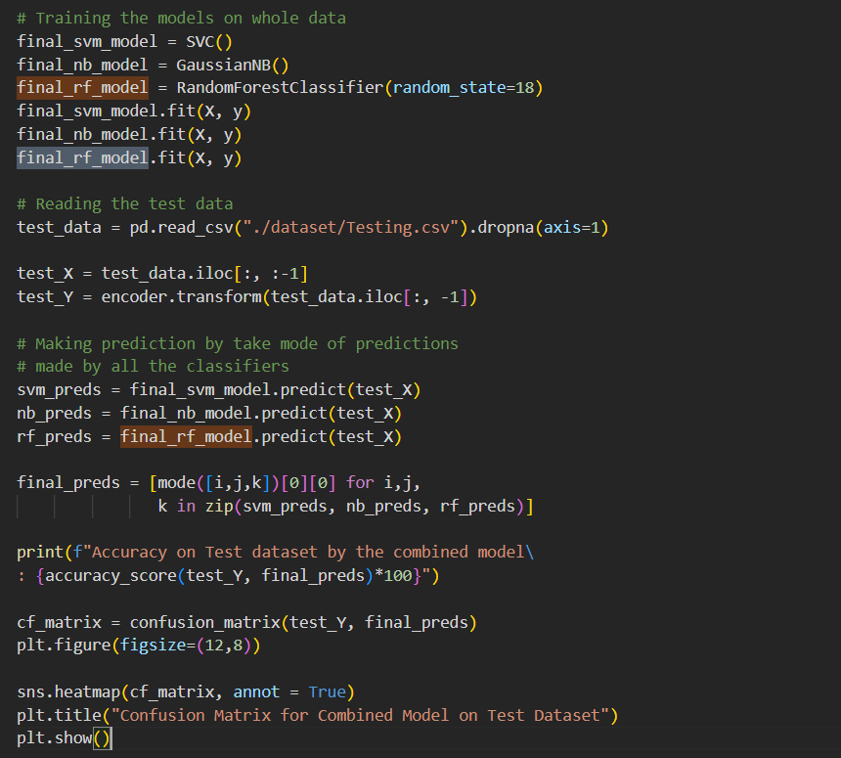

Slide 24
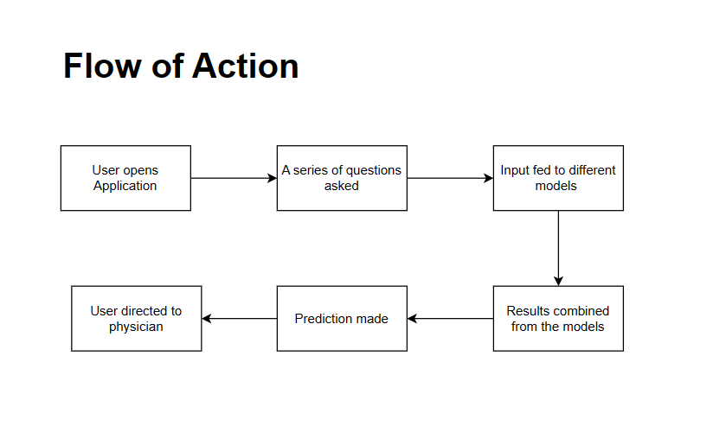
Notes:
workflow

Slide 25
Future Work
Navigating through the symptoms and diagnosis to direct the user to the right doctor
Implementing fuzzy to expand input values for users
Web interface for a more interactive experiencea

Slide 26
Limitations
Degree of correctness of prediction
Anomalies and exceptions in people
Newer diseases may not be correctly identified.

Slide 27
References
You, Yue & Gui, Xinning. (2020). Self-Diagnosis through AI-enabled Chatbot-based Symptom Checkers: User Experiences and Design Considerations.
Odegua, Rising. (2019). An Empirical Study of Ensemble Techniques (Bagging, Boosting and Stacking).
Uzun Ozsahin, Dilber & Uzun, Berna & Ozsahin, Ilker & Mustapha, Mubarak & Musa, Musa. (2020). Fuzzy logic in medicine. 10.1016/B978-0-12-818946-7.00006-8.
Perdana Wanti, Linda & Somantri, Oman. (2022). Comparing Fuzzy Logic Mamdani and Naïve Bayes for Dental Disease Detection. Journal of Information Systems Engineering and Business Intelligence. 8. 182-195. 10.20473/jisebi.8.2.182-195.
AI in healthcare: Uses, types, ecosystem, and Indian companies offering AI-driven healthcare solutions (moneycontrol.com)
Artificial Intelligence in Medical Diagnostics Systems Report 2020 (businessinsider.com)

Slide 28
Making the world a better place!
Thank you.

